Slide 1
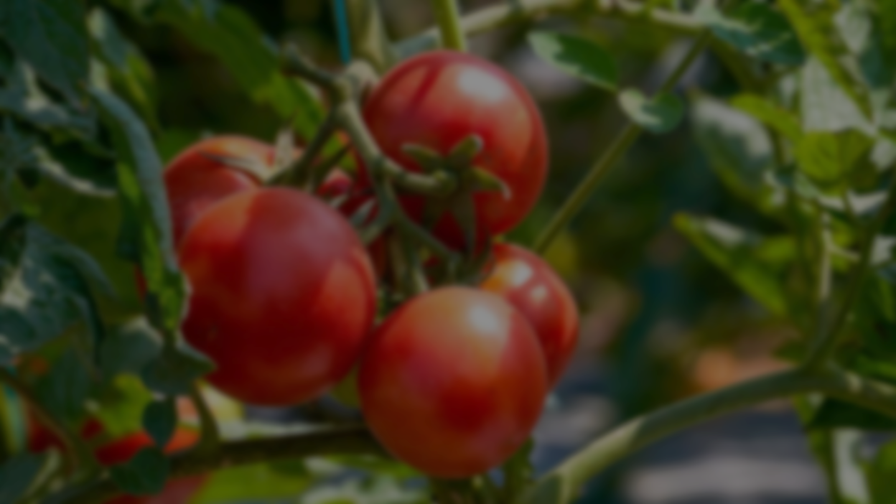
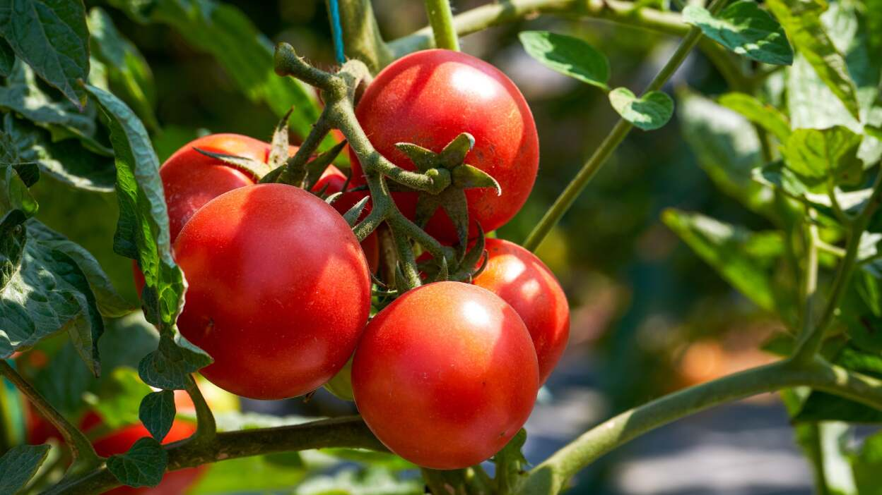
Revolutionizing Tomato Production
and quality assessment using AI
24-25J-337

Slide 2

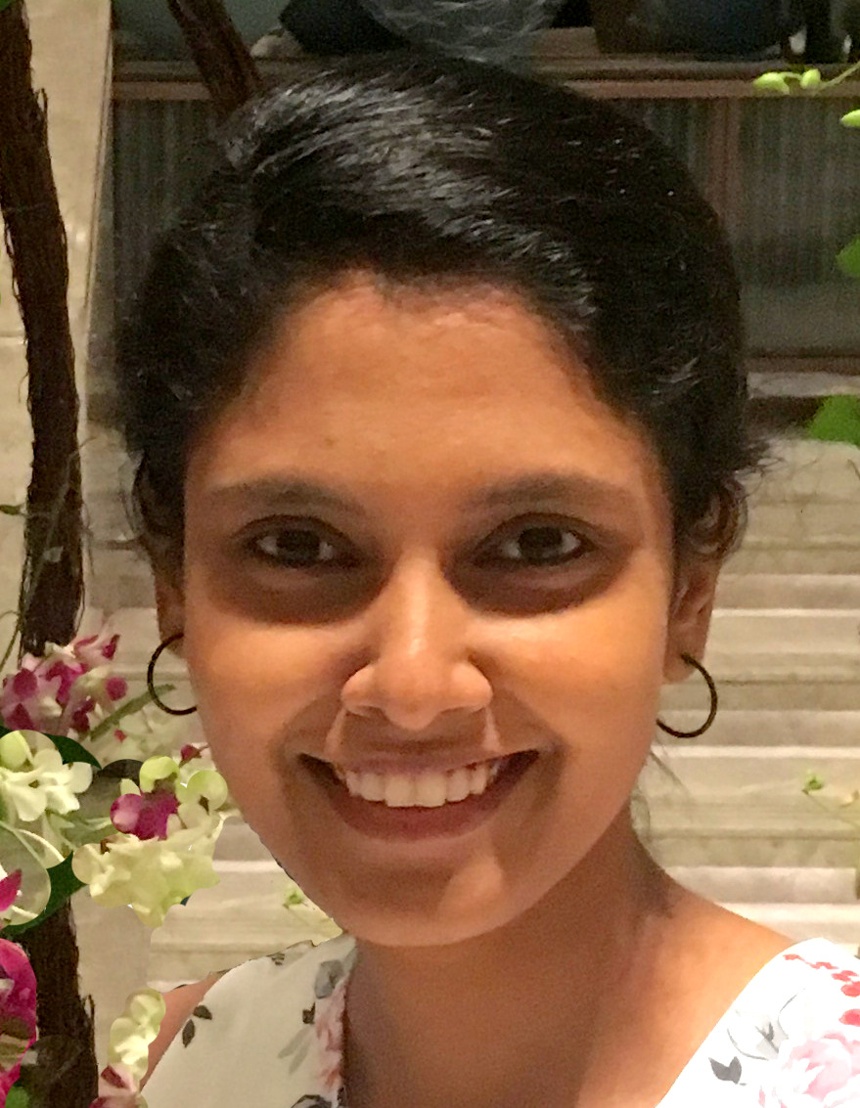
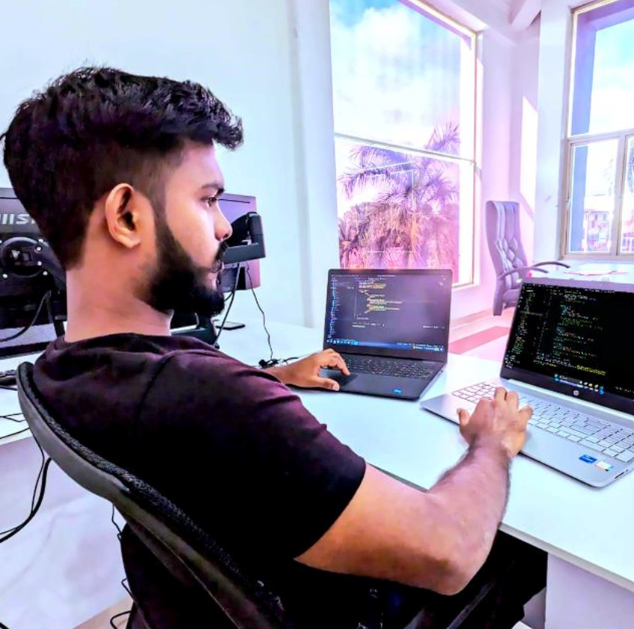
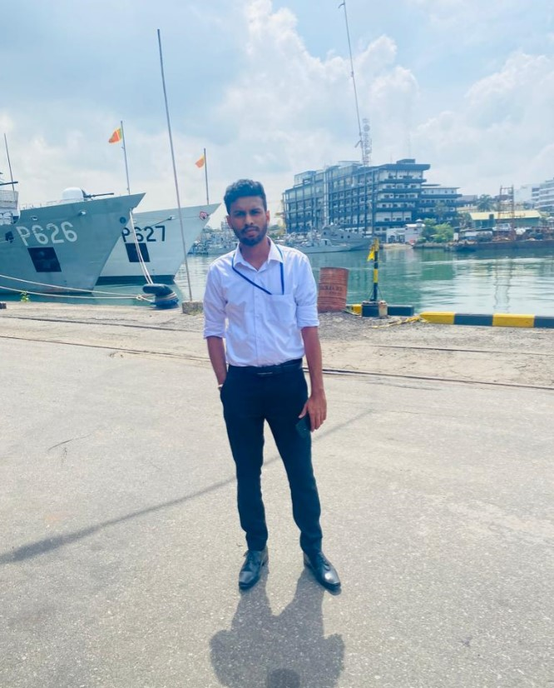
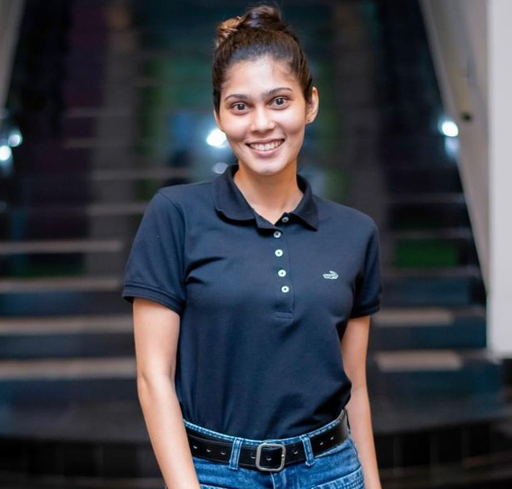
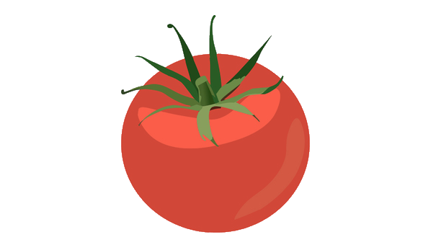
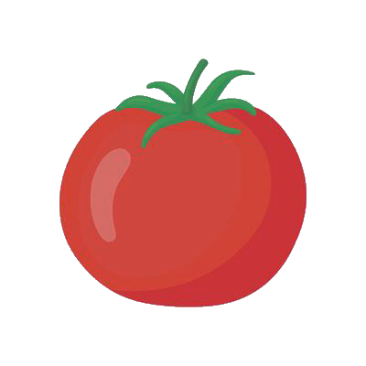
Our Team
Mr. Amila Senarathne
Supervisor
Dr. Lakmini Abeywardhana
Co-Supervisor
IT 20142728
Ranawaka. T. D
IT 21013164
G. D. M. J Samarasinghe
IT 20665548
Herath H.M.R.K

Slide 3

Introduction
Our project aims to create an AI-driven system for tomato cultivation for precise agriculture.
Key areas that our project address are inconsistent ripeness identification, manual quality grading and delayed disease detection.
The goal is to improve productivity, reduce waste, and empower farmers with a reliable tool for optimizing tomato farming practices.
Group ID 24-25J-337

Slide 4
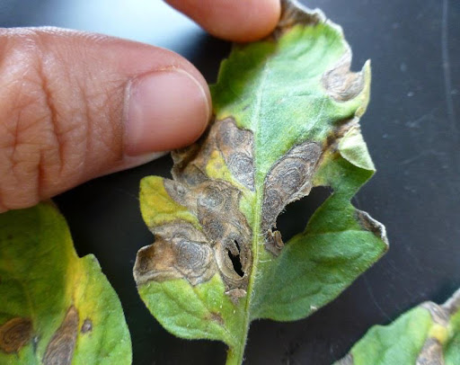
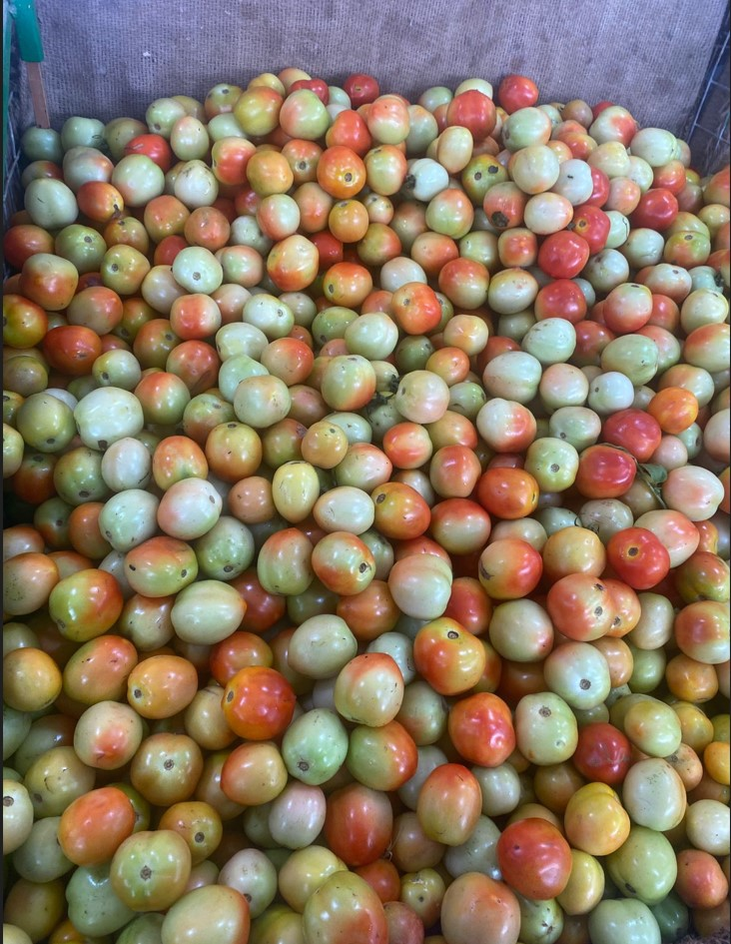
Research Problem.
Inconsistent Ripeness Detection in Tomato Harvesting
Manual and Inaccurate Tomato Quality Grading
Delayed and Inefficient Disease Identification
Limited Access to Data-Driven Insights
Group ID 24-25J-337

Slide 5
Objectives
Ripeness Detection and Harvest Prediction
Defect Detection and Quality Grading
Disease Detection and Severity Analysis
Group ID 24-25J-337

Slide 6
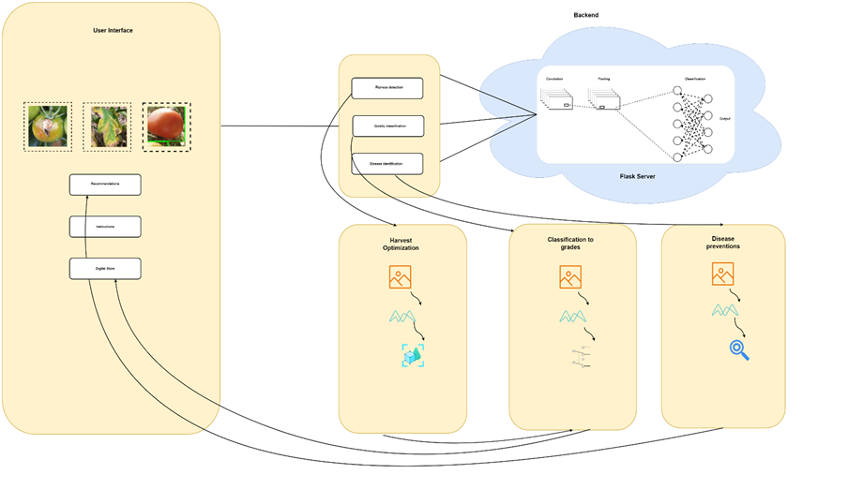
System Diagram

Slide 7
IT 21013164| Samarasinghe G.D.M.J
BSc. (Hons) Degree in Information Technology Specialization in Information Technology
IT 21013164| Samarasinghe G.D.M.J| 24-25J-377

Slide 8
Research Gap
To keep agricultural goods of high quality and market value, it is essential to prevent post-harvest losses.
Harvesting tomatoes at the right ripeness ensures optimal flavor and quality, enhancing marketability and reducing waste
Identifying ripeness stages is crucial for timing tomato harvests to ensure peak quality and market appeal.
IT 21013164|Samarasinghe G.D.M.J| 24-25J-377

Slide 9

Research Problem
Tomatoes that are harvested too early or too late will have lesser revenue due to decreased market value, therefore choosing the best harvest time is crucial for maximising quality and profitability.
IT 21013164|Samarasinghe G.D.M.J| 24-25J-377

Slide 10
Comparison
Features | Proposed Mobile Application | Other apps
Mobile App | ✅ | ✅
Input Image | ✅ | ❌
Identify Harvesting Time | ✅ | ❌
Identify Tomato Stages | ✅ | ❌
Focused Content | ✅ | ❌
Device Compatibility | IOS / Android | Android
IT 21013164|Samarasinghe G.D.M.J| 24-25J-377

Slide 11
Specific and Sub Objectives
Main Objective
Develop a mobile application to identify the best time to harvest tomatoes.
As well as the stages of ripeness and the time period during which they should be harvested.
Sub Objective
Create user friendly
Interactive mobile application
limited resource utilization
Add real time images to recognize tomatoes ripeness stages and harvesting time
IT 21013164|Samarasinghe G.D.M.J| 24-25J-377

Slide 12
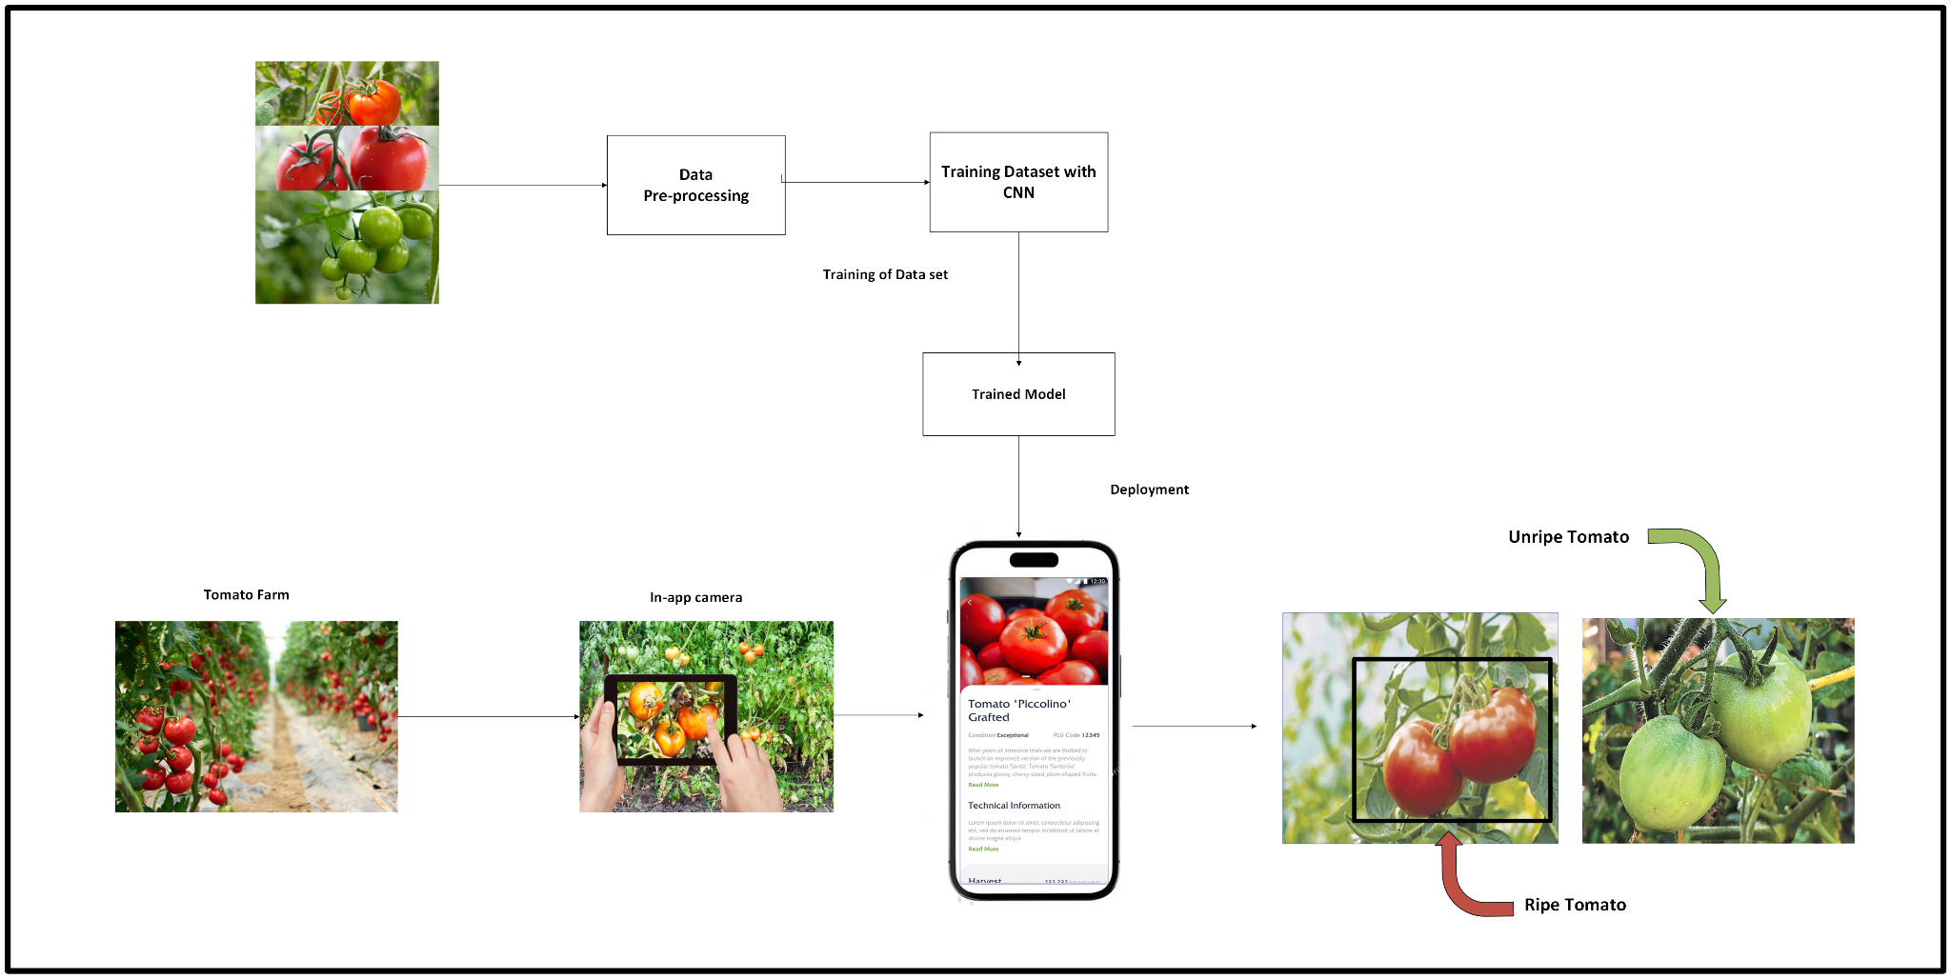
System Overview
IT 21013164|Samarasinghe G.D.M.J| 24-25J-377

Slide 13








Technologies
Mobile App
Image Recognition and Machine Learning
TensorFlow
IT 21013164|Samarasinghe G.D.M.J| 24-25J-377

Slide 14
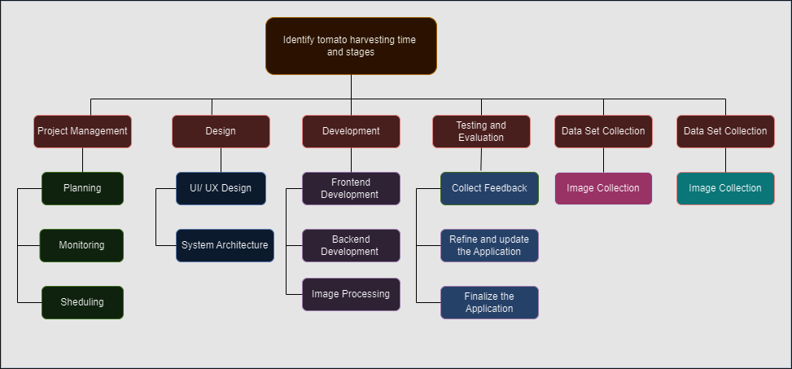
Work Breakdown
IT 21013164|Samarasinghe G.D.M.J| 24-25J-377

Slide 15
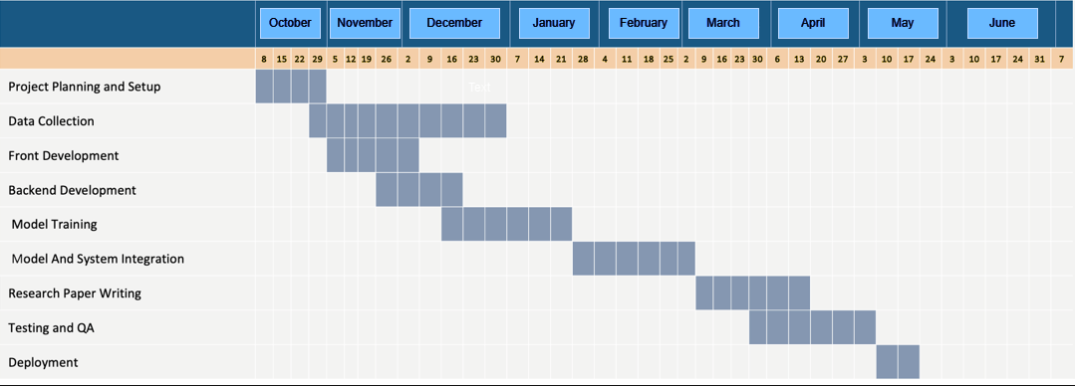
Gantt Chart
IT 21013164|Samarasinghe G.D.M.J| 24-25J-377

Slide 16
References
[1]“Reducing post-harvest losses in fruits and vegetables for ensuring food security – Case of Sri Lanka,” MOJ Food Processing & Technology, vol. Volume 9, no. Issue 1, Feb. 2021, doi: https://doi.org/10.15406/mojfpt.2021.09.00255.
[2]“VPN - Sri Lanka Institute of Information Technology,” Sliit.lk, 2024. https://vpn.sliit.lk/proxy/716c6bb7/https/ieeexplore.ieee.org/document/8574865 (accessed Oct. 14, 2024).
‌
[3]“Tomato sps 19_mag_00033,” SlideShare, 2021. https://www.slideshare.net/slideshow/tomato-sps-19mag00033/249728881#26 (accessed Oct. 10, 2024).
‌
[4]Y. H. Yap, “Tomato ripeness detection using deep learning - Universiti Teknologi Malaysia Institutional Repository,” Eprints.utm.my, 2022, doi: http://eprints.utm.my/99588/1/YapYoonHengMSKE2022.pdf.
‌[5]“VPN - Sri Lanka Institute of Information Technology,” Sliit.lk, 2024. https://vpn.sliit.lk/proxy/30dfd70f/https/ieeexplore.ieee.org/document/8489814/ (accessed Oct. 08 2024).
‌
IT 21013164|Samarasinghe G.D.M.J| 24-25J-377

Slide 17
IT 20665548|Herath H.M.R.K
BSc. (Hons) Degree in Information Technology Specialization in Information Technology
IT 20665548| H.M.R.K Herath| 24-25J-377

Slide 18
Research Gap
Extensive research on automated quality grading in agriculture highlights a gap in accurately detecting tomato defects under real-world conditions. Traditional grading relies on manual inspection, which is subjective, inconsistent, and labor-intensive, limiting precision and scalability. Existing automated approaches often fail to account for variations in lighting, background, and subtle defect characteristics.
The proposed AI-based system addresses this gap by:
Utilizing advanced image processing and machine learning for defect detection.
Implementing robust algorithms to handle diverse environmental conditions.
Aligning grading with commercial quality standards for consistency.
IT 20665548| H.M.R.K Herath| 24-25J-377

Slide 19
Research Problem
How to develop an optimal solution for accurately distinguishing tomato defects from each other?
Evaluate the severity of detected defects for quality grading.
To what extent can tomato defects be identified and graded according to commercial standards using machine learning and image processing techniques?
IT 20665548| H.M.R.K Herath| 24-25J-377

Slide 20
Comparison
Manual Grading:
Relies on human inspectors, making the process subjective and prone to inconsistencies.
Time-consuming and labor-intensive, limiting scalability for large-scale operations.
Difficult to detect subtle defects and evaluate uniformity consistently.
Prone to fatigue-related errors, leading to variations in grading quality.
Automated Defect Detection and Quality Grading:
Uses image processing and machine learning to detect defects with high accuracy and consistency.
Provides objective grading based on predefined commercial standards, ensuring uniformity.
Faster processing speeds enable scalable quality control for large quantities of tomatoes.
Can be trained to identify subtle defects and assess their severity for more precise grading.
Robust against variability in environmental conditions when equipped with proper preprocessing techniques.
IT 20665548| H.M.R.K Herath| 24-25J-377

Slide 21
Sub Objectives
Developing an image processing pipeline.
Implementation of an error detection algorithm.
Assessing the severity of defects.
Classification of quality ratings.
Optimizing the system for real-time performance.
Verification and testing.
IT 20665548| H.M.R.K Herath| 24-25J-377

Slide 22
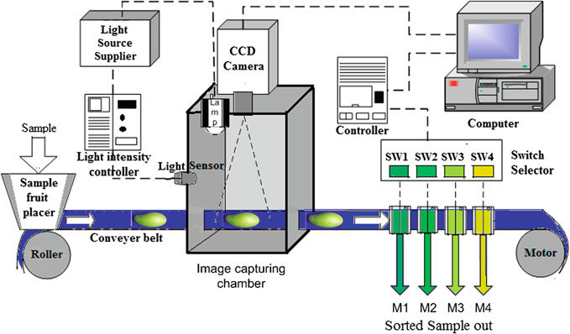
System Overview
IT 20665548| H.M.R.K Herath| 24-25J-377

Slide 23
Technologies
IT 20665548| H.M.R.K Herath| 24-25J-377

Slide 24
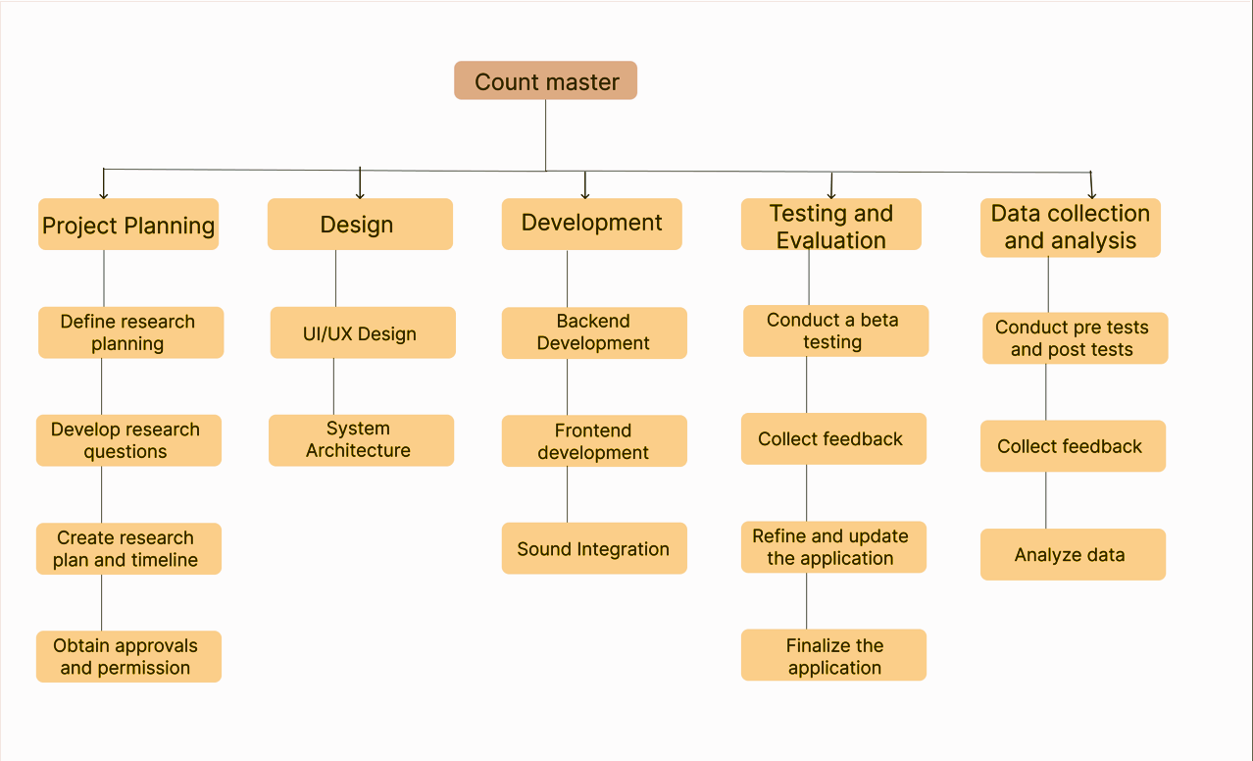
Work Breakdown
Defect Detection and Quality Grading
IT 20665548| H.M.R.K Herath| 24-25J-377

Slide 25
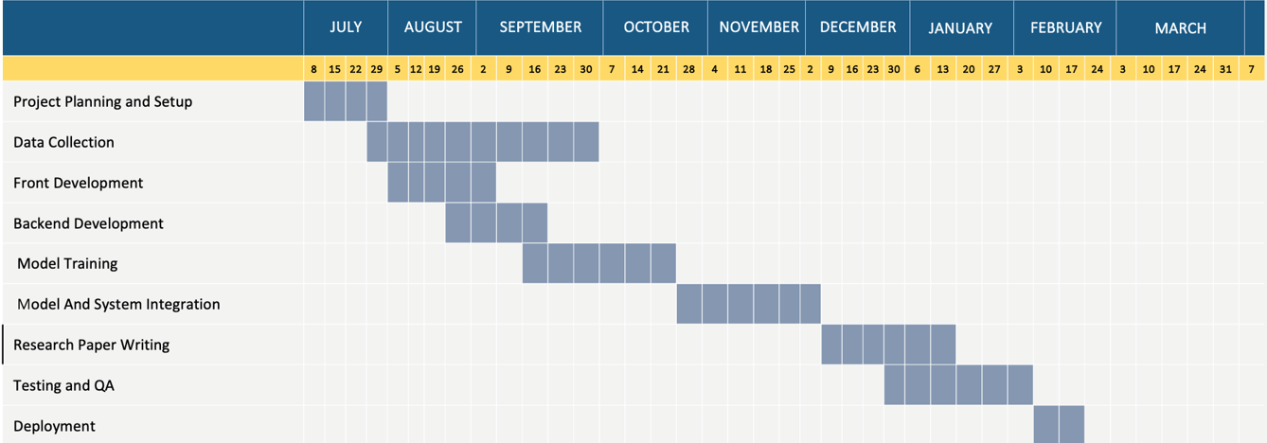
Gantt Chart
IT 20665548| H.M.R.K Herath| 24-25J-377

Slide 26
References
A microcontroller based machine vision approach for tomato grading and sorting using SVM classifier [https://www.sciencedirect.com/science/article/abs/pii/S0141933119307057]
Fruit-Based Tomato Grading System Using Features Fusion and Support Vector Machine [https://link.springer.com/chapter/10.1007/978-3-319-11310-4_35]
Computer Vision Based Fruit Grading System for Quality Evaluation of Tomato in Agriculture industry [ https://www.sciencedirect.com/science/article/pii/S1877050916001861 ]
A cost effective tomato maturity grading system using image processing for farmers [ https://ieeexplore.ieee.org/abstract/document/7019591 ]
IT 20665548| H.M.R.K Herath| 24-25J-377

Slide 27
IT 20142728| Ranawaka. T.D
BSc. (Hons) Degree in Information Technology Specialization in Information Technology
IT 20142728|Ranawaka. T. D| 24-25J-377

Slide 28
Research Gap
extensive research on tomato disease diagnosis, which mostly concentrates on human inspection and simple image processing techniques.
Traditional methods rely on farmers' eye inspection, which is error-prone and frequently causes delayed disease response.
While most current research focuses on specific illnesses, there are no complete solutions that combine automated, real-time disease detection and severity evaluation.
The suggested system addresses this gap by providing:
Image processing done automatically to identify diseases early.
Multiple tomato illnesses are identified in real time using machine learning algorithms.
The objectives of this approach are to decrease crop loss, enhance disease control, and give tomato growers a scalable tool.
IT 20142728|Ranawaka. T. D| 24-25J-377

Slide 29
Research Problem
How to find a optimum solution for identify diseases apart from each other accurately?
Evaluate the severity of identified disease ?
To what extent may early-stage tomato illnesses be identified using machine learning and image processing?
IT 20142728|Ranawaka. T. D| 24-25J-377

Slide 30
Specific and Sub Objectives
Improve Disease Detection and Management in Tomato Farming
Create an automated system that can identify and categorize tomato illnesses early on using machine learning and image processing.
Evaluate how well the system works to improve overall disease control for tomato growers and reduce crop loss.
IT 20142728|Ranawaka. T. D| 24-25J-377

Slide 31
Sub Objectives
Design and Development of the Disease Detection System
Testing and Validation of the Disease Detection System
Mobile Application Integration
Real-Time Decision Support for Farmers
IT 20142728|Ranawaka. T. D| 24-25J-377

Slide 32






System Overview
ISP
Flask
Backend
user interface
My component
IT 20142728|Ranawaka. T. D| 24-25J-377

Slide 33
Technologies
IT 20142728|Ranawaka. T. D| 24-25J-377

Slide 34
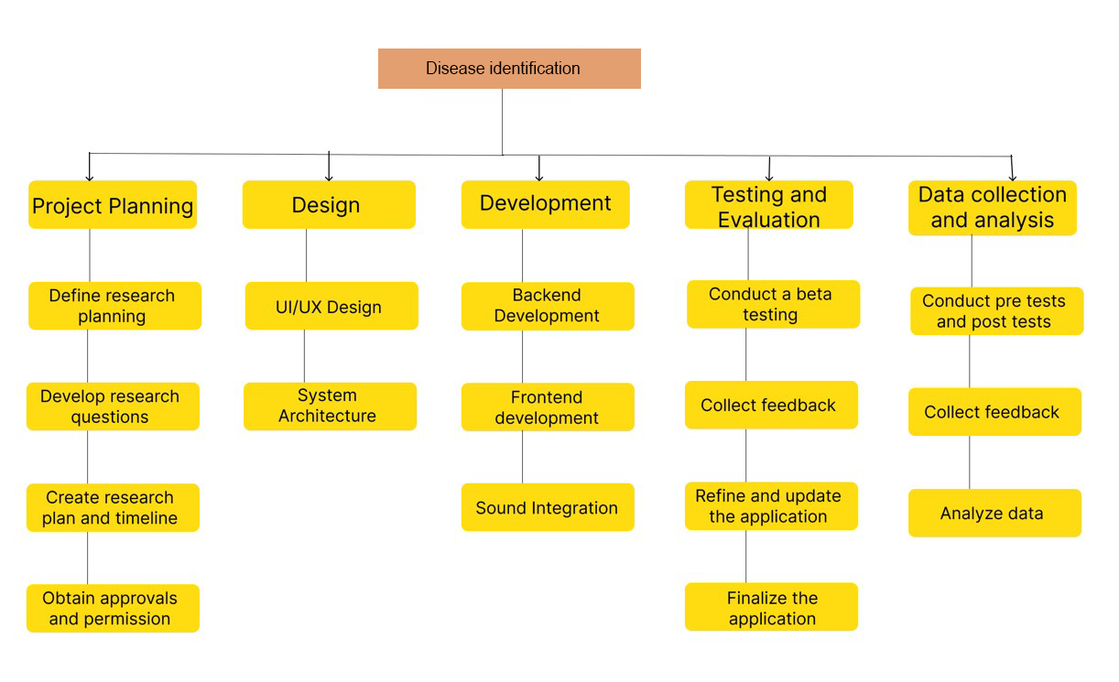
Work Breakdown
IT 20142728|Ranawaka. T. D| 24-25J-377

Slide 35
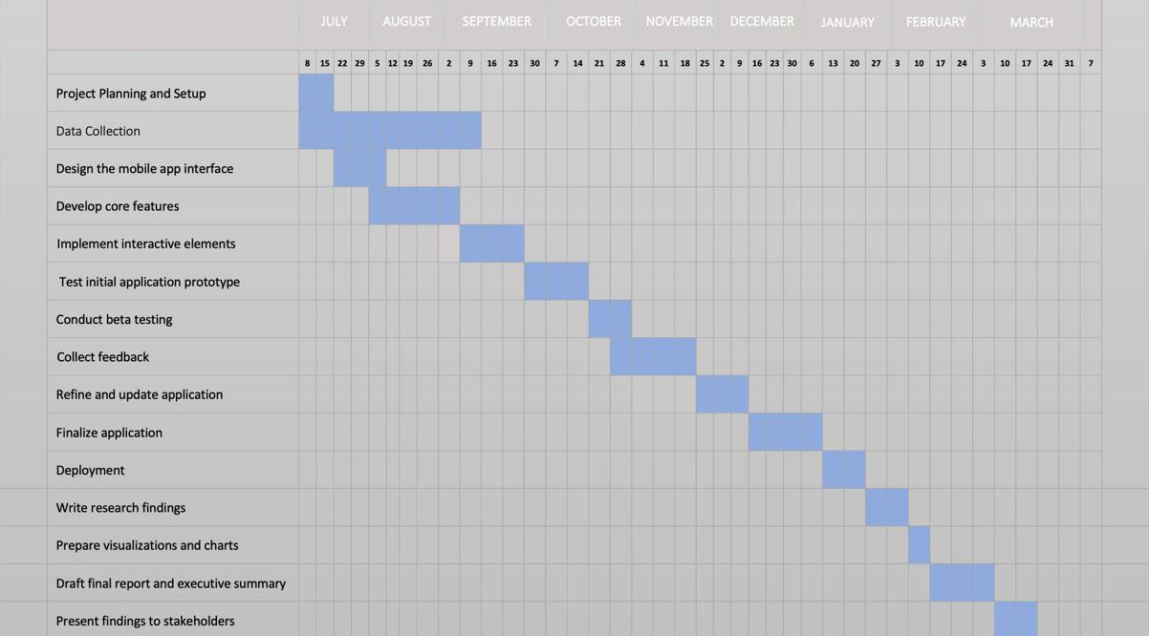
Gantt Chart
IT 20142728|Ranawaka. T. D| 24-25J-377

Slide 36
References
https://www.sciencedirect.com/science/article/pii/S0168169920302052
https://www.sciencedirect.com/science/article/pii/S1877050920306906
https://plantmethods.biomedcentral.com/articles/10.1186/s13007-024-01188-1
IT 20142728|Ranawaka. T. D| 24-25J-377

Slide 37
Commercialization
Offer 6 months as a free application for the tomato cultivators. During that time we can improve the system according to the feedback of users. After 6 months we deploy the stable version with monthly 2$ subscription. Application will build as a cross platform application.

Slide 38
Budget
Description
fee(Rs)
Field visit
3000
AWS server usage
300
Datasets
2000
Total
5300

Slide 39
Thank You!

